Slide 1
Timebox 6
Josh Becker, Ryan Bone, Jack Craft, Ed Grundner, Navid Matin, Hector Medina-Fetterman, Chase Plante

Slide 2
Game Theme

Slide 3
Timebox 6 changes
Player utility abilities
More planets
Unique Boss Behaviors
Dialog
Refactoring
More Turrets
Spice up the fps mechanic

Slide 4
New Bosses
Unique boss for each planet
BatCat Boss
Troll Boss
Frog Boss
Unique abilities for each boss
Balanced with different stats for each boss
Notes:
Navid

Slide 5
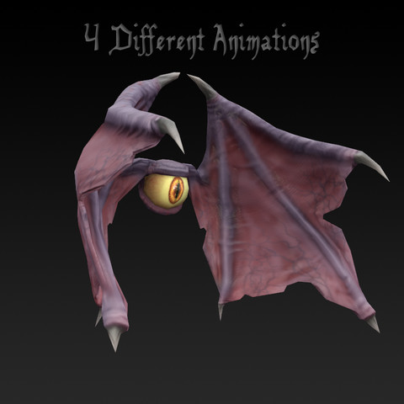
BatCat Boss
Quick Boss
Quick Movement
Lighter Attacks
Knockback Ability
Possibly getting a new model
Notes:
Navid

Slide 6
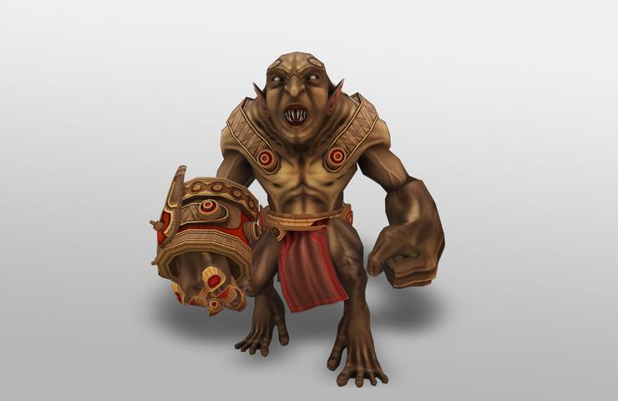
Troll Boss
Slow Boss
Slow Movement
Heavy Attacks
Crushing Attack
Attack hits player for large amount of health
Frog Planet Boss
Notes:
Navid

Slide 7
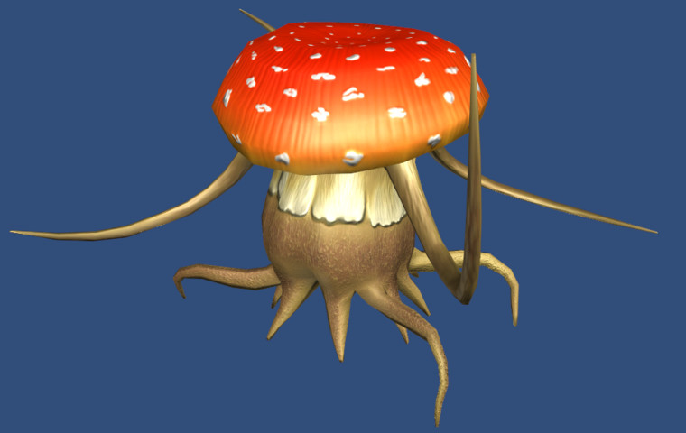
Fungi Boss
Stun Boss
Quick Movement
Medium Attacks
Stun Ability (Planned)
Notes:
Navid

Slide 8
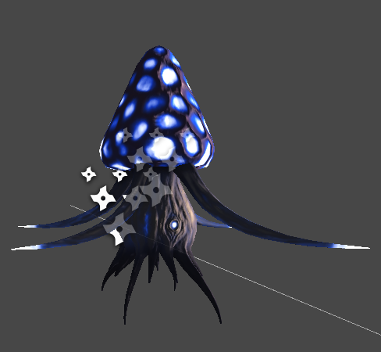
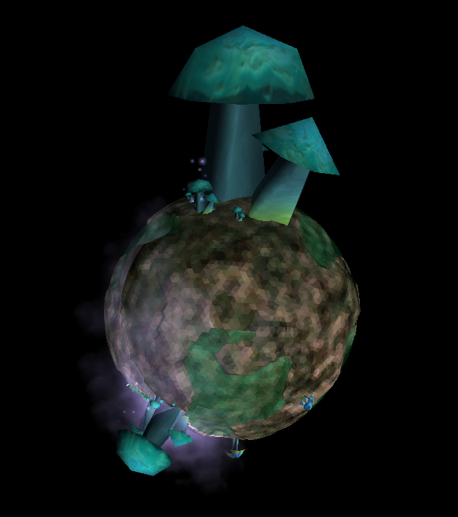
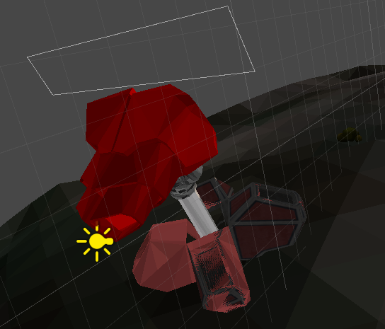
More Planets: Fungi Planet
It’s a planet covered in fungus!
Sentient fungi patrol the decaying world.
Turrets on this planet carry
poisonous spores that makes
your character run
around in irrational fear.
Notes:
Navid

Slide 9
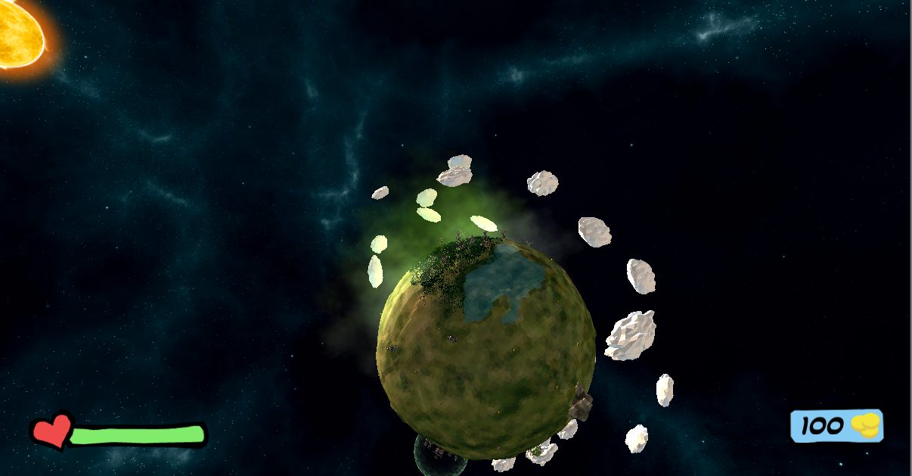
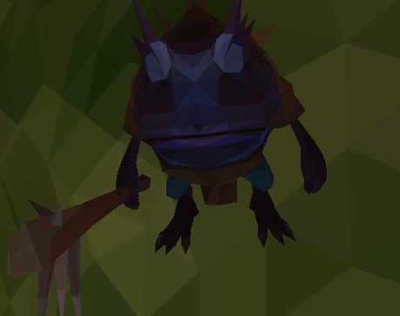
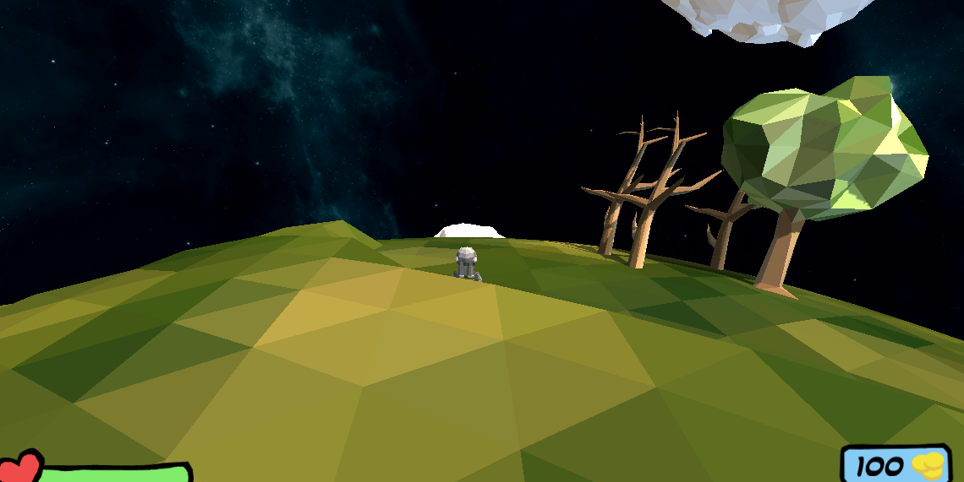
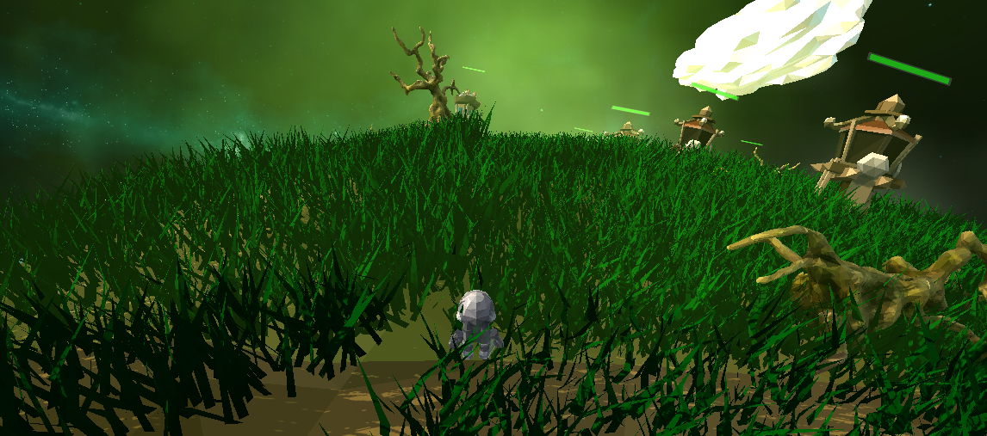
More Planets: Frog Planet
Planets of Toads
Wet Planet
Ruled by mighty trolls
Attack in large numbers!
Notes:
Navid

Slide 10
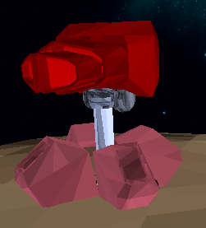
New Towers
Fear
Projectiles cause enemies to flee the battle.
Notes:
Navid

Slide 11
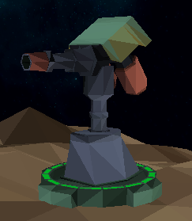
New Towers
Poison
Projectiles cause enemies to take damage over time.
Notes:
Navid

Slide 12
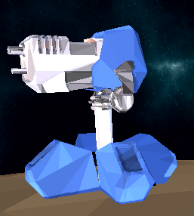
New Towers
Slow
Projectiles slow down enemy movement and effect all enemies within a given radius of the collision.
Notes:
Navid

Slide 13
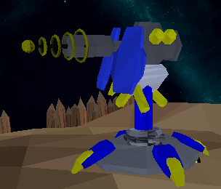
New Towers
Betrayal
Projectiles cause enemies to fight for you for a short time.
Notes:
Navid

Slide 14
Tower Combos
Turret determines initial damage, auto target range, and rate of fire.
Base adds a multiplier.
All other type effects are incorporated.
Fear-Slow tower will make all enemies within a radius of the projectile’s collision run away slowly.
Rocket-Betrayal tower will knock back enemies and make the one hit by the projectile fight for you.

Slide 15
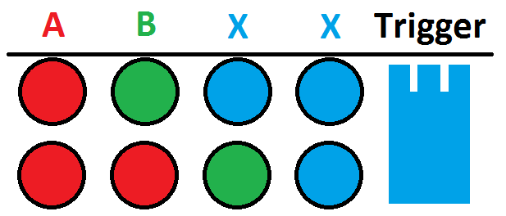
Tower Placement Revamp
FIFO Queue with confirmation

Slide 16
Tower Placement Revamp
Advantages
Quicker placements (4 button clicks to 2-3)
More forgiving of accidental button presses
Eliminates pointless bases
More focus on combinations, less on building
Problems
No way to cancel placement (yet!)
Lacks a visual representation (GUI or Turret “Hologram”)

Slide 17
Player Abilities
Knockback
Does no damage, used when getting overwhelmed
Repair Turrets
Create Portals
Can only create two
Enemies can’t use them or destroy them currently
Gather Resources (not implemented)
Deploy automated helper to gather resources for short time
Notes:
Knockback is down on the dpad or 5
Repair is left on the dpad or 6
Portal is right on the dpad or 7
Gather is up on the dpad or 8

Slide 18
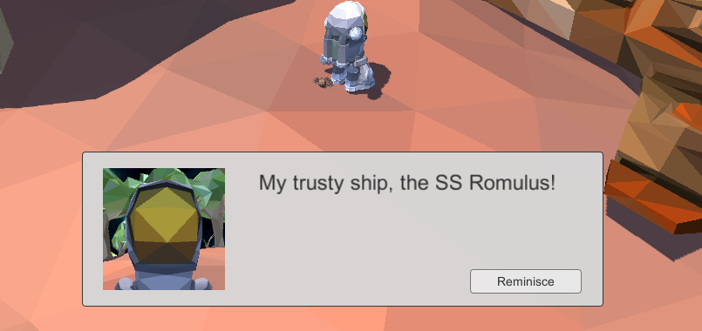
Dialog
Dialog System allows us to display story elements
Dialog panel contains moving head frame, text, and a button

Slide 19
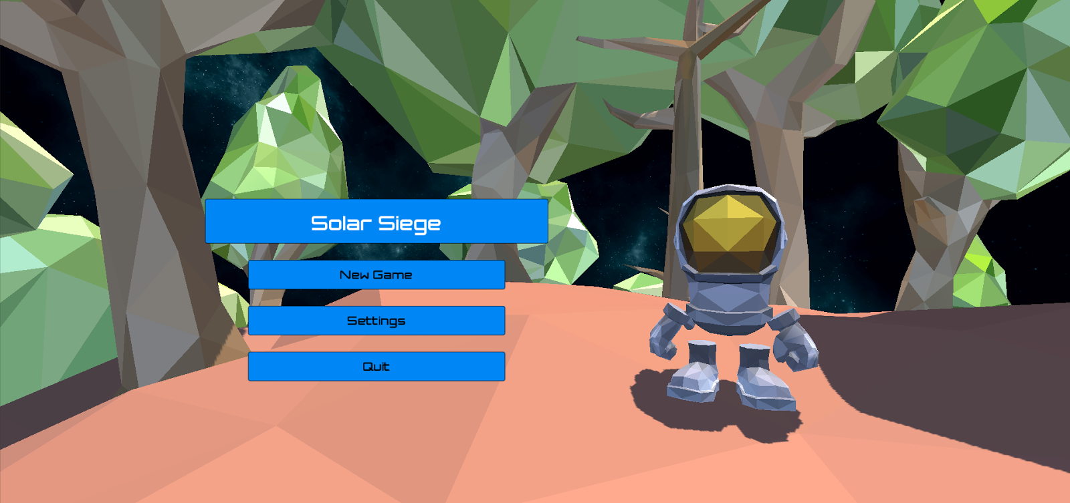
Menu

Slide 20
Final Product To Dos
Game Balancing
Tower Stats vs Enemy Stats
Currency
Win condition get added
Determine game progression order

